Slide 1
Git Tutorial
Dr. Jeroen Engelberts, Research Software Engineer, Information Management and Consulting

Slide 2
Outline
Introduction IMC and Scientific Development Team
Continues where “Introduction to Git” left off:
https://jjengelberts.github.io/eur-git-101/
Hands-On
https://learngitbranching.js.org/
https://jjengelberts.github.io/eur-git
Github
Forks, Pull requests and collaborators
https://guides.github.com/activities/hello-world
Questions & Answers

Slide 3
IMC – Information Management & Consulting
Consultancy
Functional Application Management
Learning & Innovation Team
IT Development
Web Development
Research Software Engineering & Consulting
Govert Buijs, Erik Kemperman, Paul Kievits and Jeroen Engelberts
Email: rsec@rsm.nl
Telephone: 010-4081930
Location: Mandeville (T) 06-13

Slide 4
Version Control – What & Who?
What is version control?
“Version control is a system that records changes to a file or set of files over time so that you can recall specific versions later.” [Pro Git, Apress, 2nd – 2014, Scott Chacon, Ben Straub]
Who should use, or who could benefit from version control?
Any software developer
Anyone writing a bunch of articles, like a PhD thesis ☺
Any group of people working together with many (text) files

Slide 5
Version Control – Why?
Advantages
Differences over time can be reviewed easily
Changes can be unrolled
It enables concurrent working on the same files
Changes are linked to individuals
Logging is kept (metadata) for each change
Date
Time
Description

Slide 6

Local Version Control System
Pro
Version control!
Cons
Single user
Limited collaboration

Slide 7
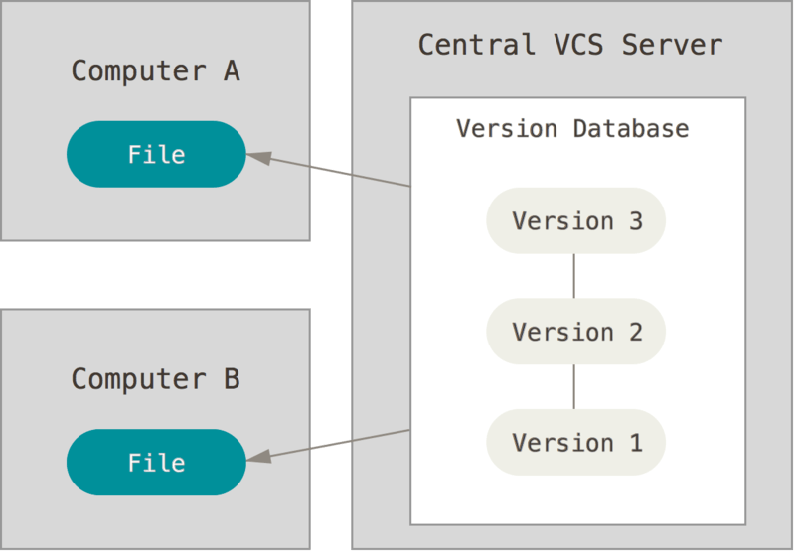
Centralized Version Control System
Pros
Version control!
Multiple users
Collaboration
Cons
Revisions not local
Merging can be challenging

Slide 8
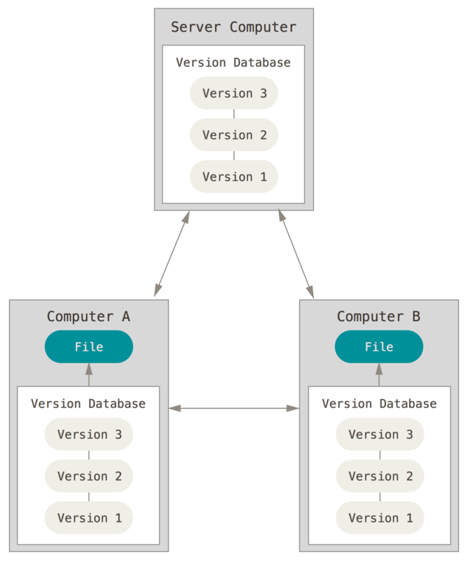
Distributed Version Control System
Pros
Version control!
Multiple users
Collaboration
Revisions are locally cloned
Con
Merging complete branches can be hard or even impossible

Slide 9
Git commands (recap of 101)
git clone – Clones a remote repository
git add – Stage files and directories to be committed
git commit – Commit changes to staged files

Slide 10
Git commits
Commits can be traced in five ways
Their unique hexadecimal string
Their comment, or message
Their branch label
Their tag
Their relative position (HEAD)

Slide 11
Git commit, branch, merge and rebase
Please go to the following site: https://learngitbranching.js.org/
Make the exercises in the “Introduction Sequence” section
----------
Open up “git bash”, or a terminal where “git –V” gives you the version of Git.
Follow along with me, I’ll show you:
git status & git log
git commit
git add
git branch
git merge, git rebase, git rebase -i

Slide 12
Conflicts
Conflicts arise when Git is not able to unravel commits
Occur, when many branches are used (even for a single user)
Or, when different people are working on the same files
----------
Follow me on “git bash” to create a conflict ourselves.
… and let’s resolve it.

Slide 13
HEAD, HEAD^, HEAD^n and HEAD~n
Please go to the following site: https://learngitbranching.js.org/
Make the exercises in the “Ramping Up” section
----------
Open up “git bash”, or a terminal where “git –V” gives you the version of Git.
Follow along with me, I’ll show you:
HEAD
HEAD^, and HEAD^2
HEAD~n
→ Now, make exercises in the “Moving Around” and “A Mixed Bag” sections.

Slide 14
Github
Hopefully, you created a Github-account (otherwise, do so now)
Go to https://learngitbranching.js.org/
Click on “Remote” tab
Make exercises in section “Push & Pull -- Git Remotes!”
Type along with me and create a Fork of https://github.com/jjengelberts/eur-git
Make a modification (locally), and create a Pull Request
I’ll show you how to handle the Pull Requests
----------
In the meantime, I have added your Github-account as collaborator to “eur-git”
Clone the repo, make some changes, commit, and push.

Slide 15

Questions and Answers

